Slide 1
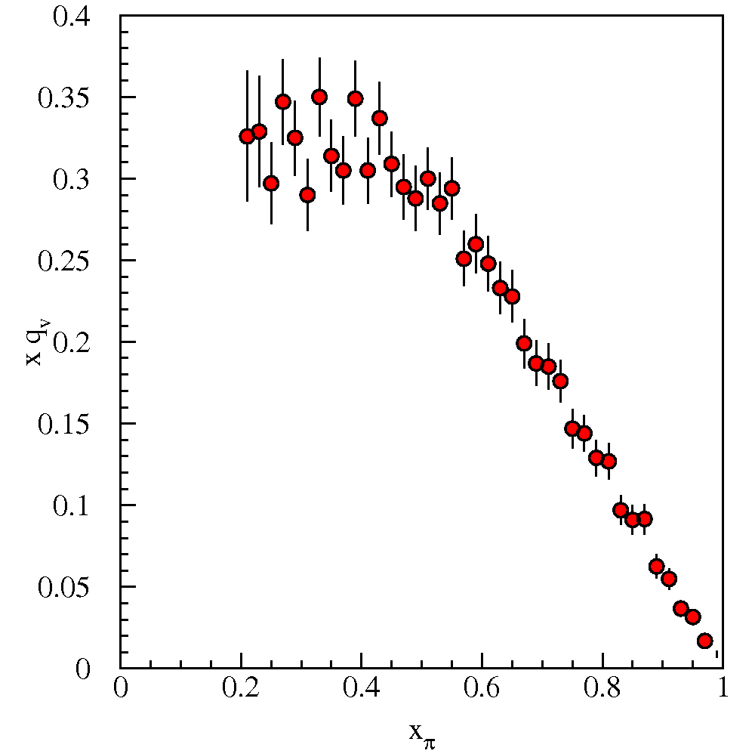
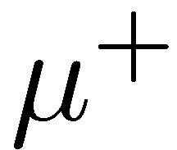
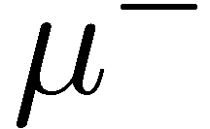
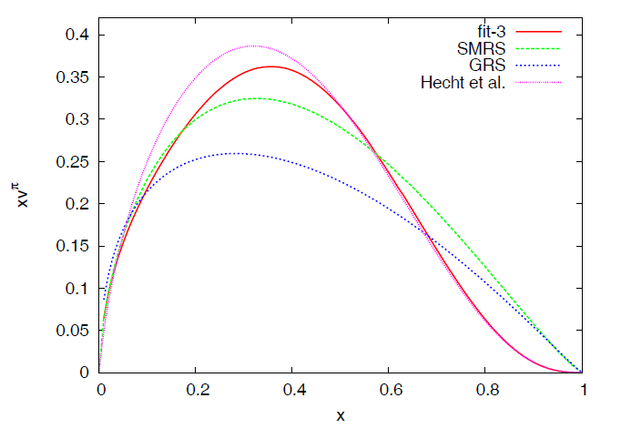
Exploring the Structure of the Pion
Paul E. Reimer
Physics Division
Argonne National Laboratory
14 October 2010
Why are we interested in the pion?
What do we know about the pion?
What do we expect? (Dyson-Schwiner equations and the high-x_{π} region).
What does the data tell us?
Work done with R. Holt and K. Wijesooriya
Aicher, Schäfer and Vogelsang, arXiv:1009.2481
This work is supported in part by the U.S. Department of Energy, Office of Nuclear Physics, under Contract No. DE-AC02-06CH11357.

Slide 2
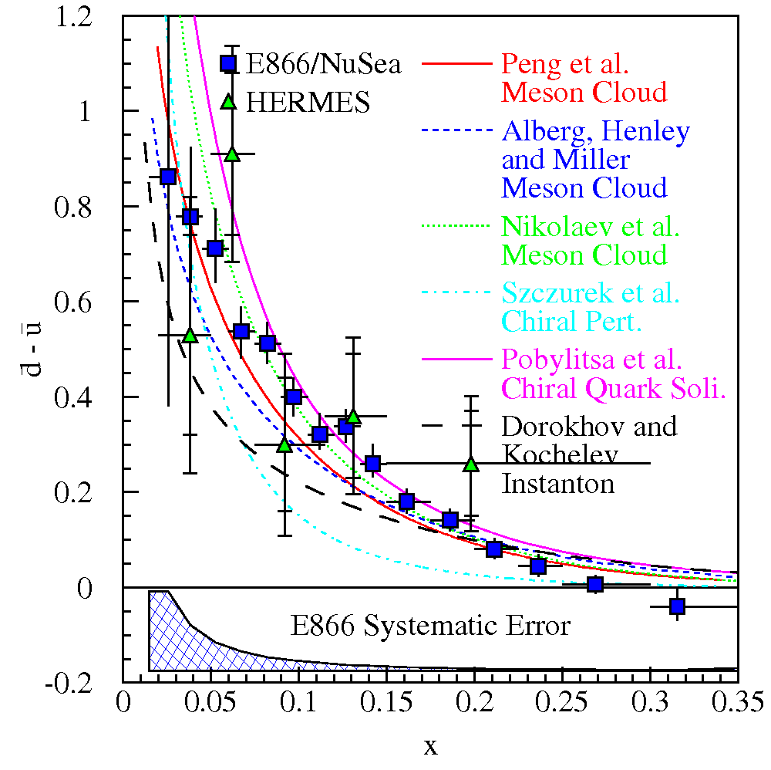
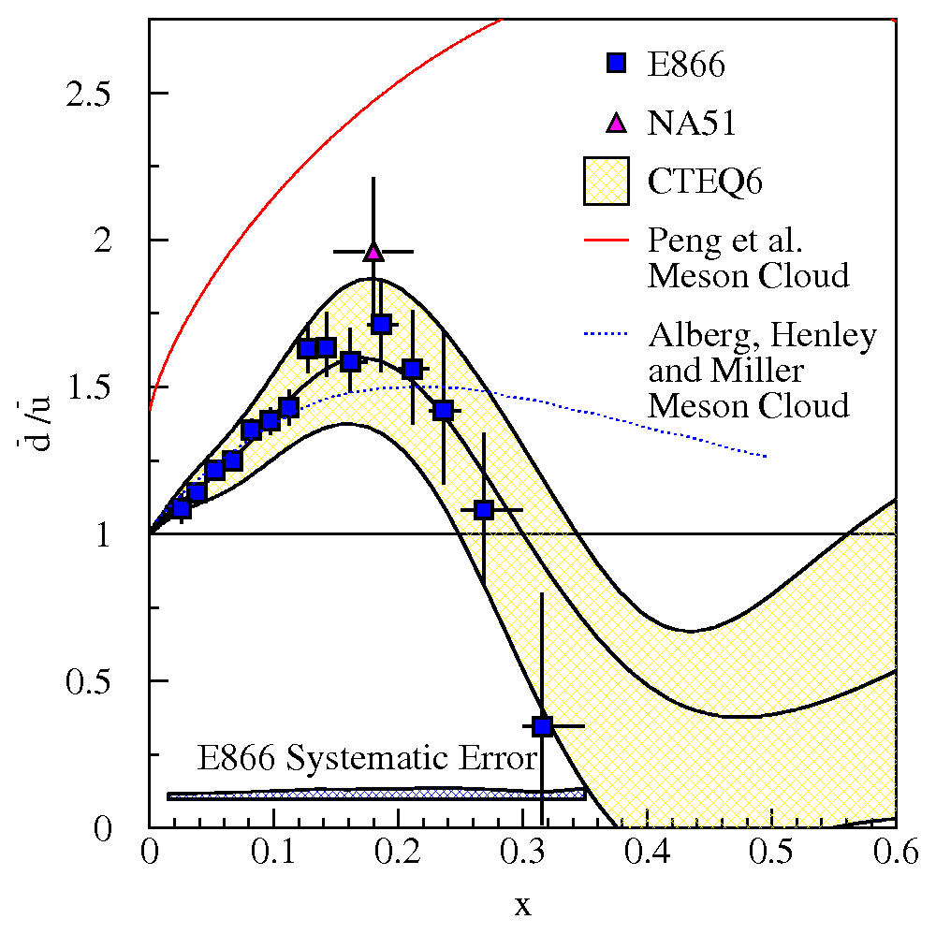
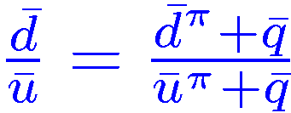
Why are should you be interested in the pion?
Explains quark asymmetry in nucleon sea.
Meson Cloud in the nucleon
Sullivan process in DIS
|p⟩ = |p₀⟩ + α |Nπ⟩+ β|Δπ⟩+ . . .
Chiral Quark
Interaction between Goldstone Bosons and valence quarks
|ui!|dπ⁺i and |di!|uπ⁻i
Perturbative sea apparently dilutes meson cloud effects at large-x

Slide 3
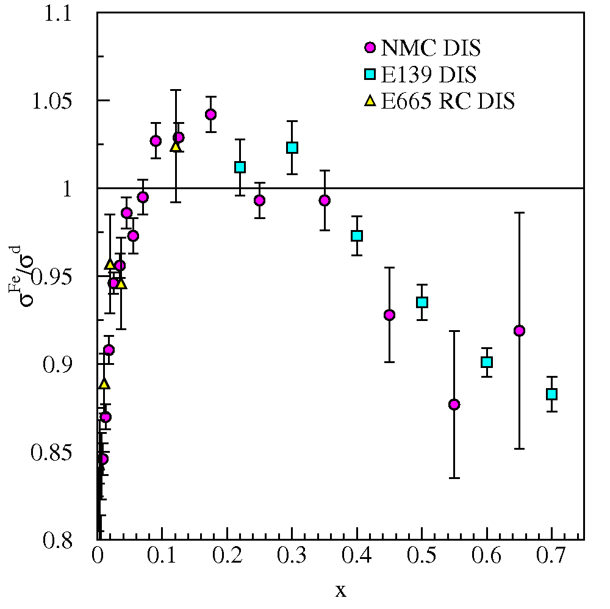
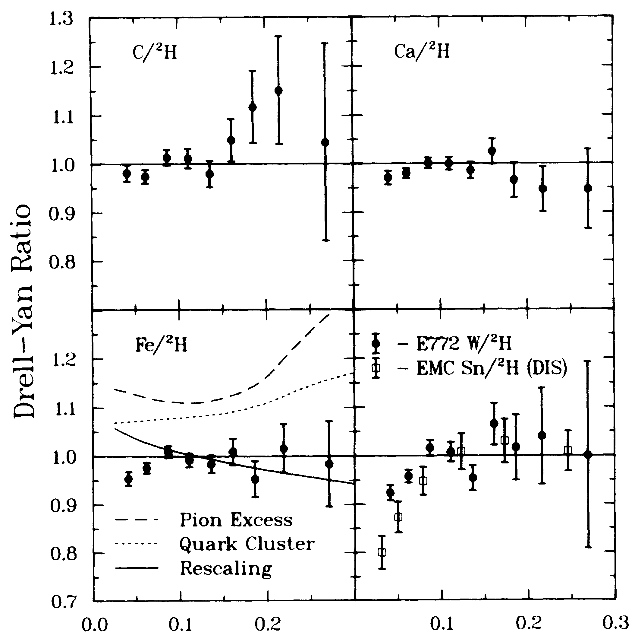
Why are should you be interested in the pion?
Explains quark asymmetry in nucleon sea.
Key role in nuclear binding and structure (maybe?).
Alde et al (Fermilab E772) Phys. Rev. Lett. 64 2479 (1990)

Slide 4
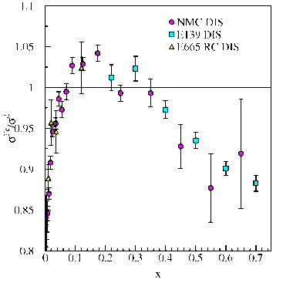
Why are should you be interested in the pion?
Explains quark asymmetry in nucleon sea.
Key role in nuclear binding and structure (maybe?).
Pion parton distributions play a role in nucleon and nuclear parton distributions
Note: QCD tells us how the parton distributions evolve, once we know them, but not what they are.
Simple quark-antiquark system (valence).
Should have an easy theoretical interpretation.
What about mass—constituent quark mass ≈300 MeV each?
QCD’s Goldstone Boson
How do we treat 3 and 4 in a unified way?

Slide 5
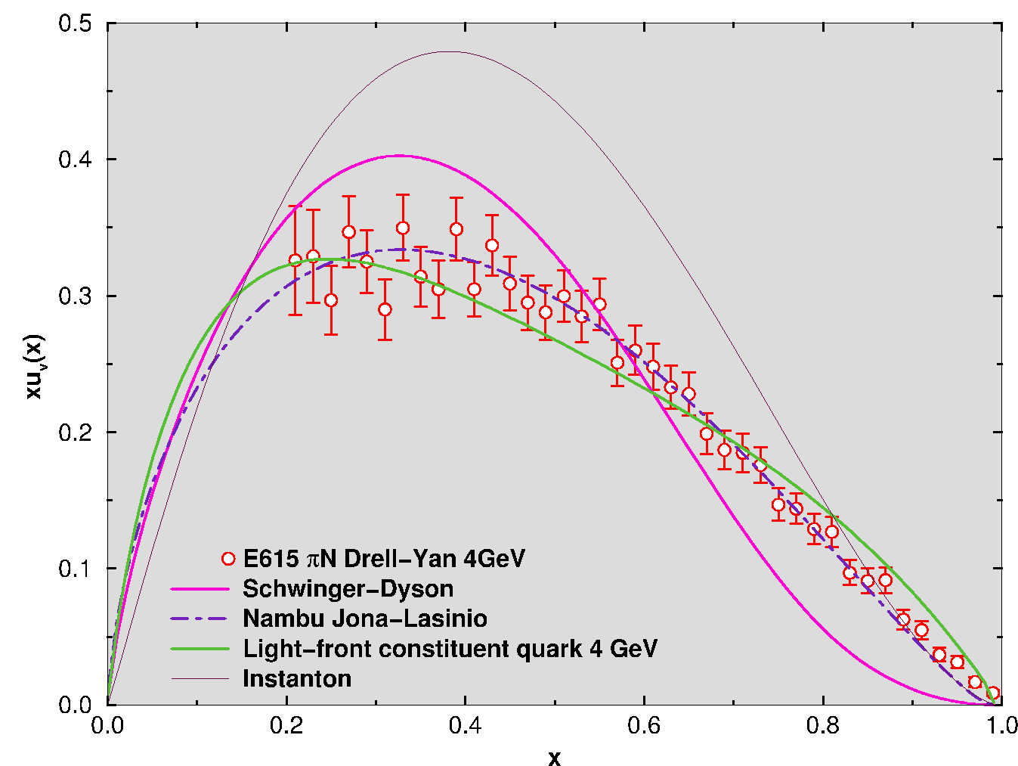
Models of the Pion
Nambu and Jona-Lasinio Model:
R. Davidson, E. Arriola, PLB (1995)
J.T. Londergan et al. PLB (1994).
T. Shigetani et al. PLB (1993).
Dyson Schwinger Equation:
M. Hecht et al. PRD (2001).
Chiral Quark Model:
K. Suzuki, W. Weise, NPA (1998).
D. Arndt, M. Savage, nucl-th (2001)
Light-front constituent quark models:
Gerry Miller, et al. (too many to list).
Instanton Model:
A. Dorokhov, L. Tomio, PRD (2000)
QCD Sum Rule Calculations
A. Bakulev et al. PLB (2001).
Lattice Gauge
C. Best et al. PRD (1997).
At some base q₀
NJL: xq(x)/ (1-x)^{β} β = 1
pQCD: xq(x)/ (1-x)^{β} β = 2
DSE: xq(x)/ (1-x)^{β} β ¼ 1.9
Evolution to experimental Q increases β.

Slide 6
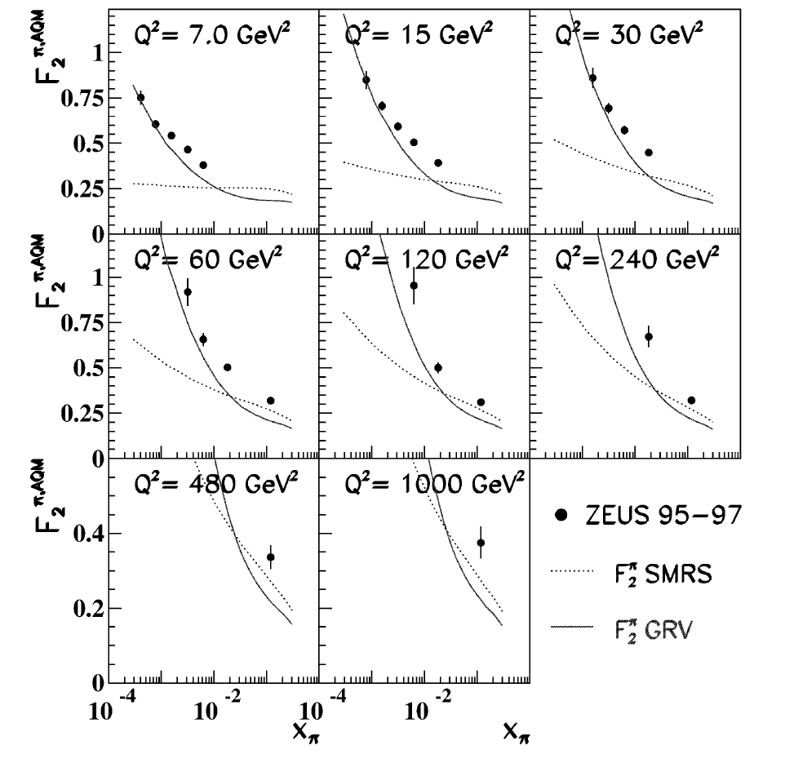
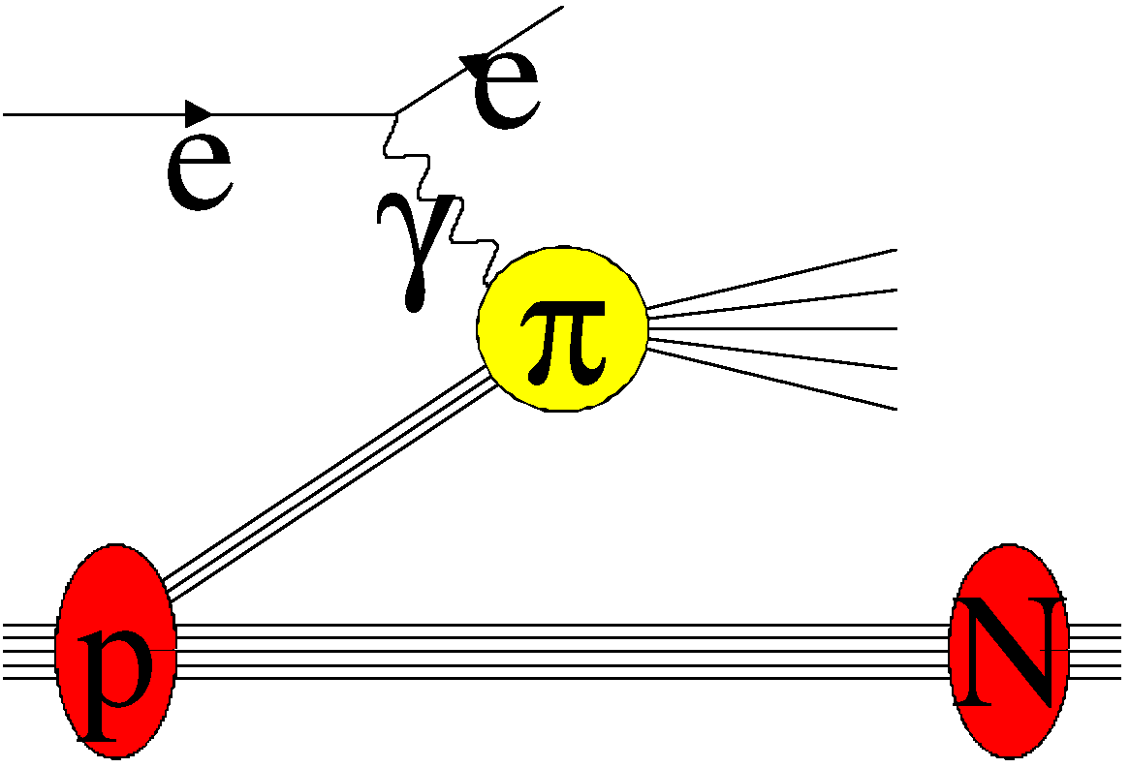
Experimental Tools for π structure
Deeply Inelastic Scattering:
“pion targets are not abundant” Hecht
DIS on virtual pions:
ep→eNx HERA data [ZEUS, NPB637 3 (2002)]
Possible JLab and EIC.
Low-x data (Different Workshop?)

Slide 7
Experimental Tools for π structure
Deeply Inelastic Scattering:
“pion targets are not abundant” Hecht
DIS on virtual pions:
ep→eNx HERA data [ZEUS, NPB637 3 (2002)]
Possible JLab and EIC.
Low-x data (Different Workshop?)
Direct photos in πp interactions
Sensitive to gluon distributions.
[CERN WA 70, Z. Phys. C37 535 (1988)]
Assume parameterization
SMRS, PRD45 2349 (1992)

Slide 8
Experimental Tools for π structure
Deeply Inelastic Scattering:
“pion targets are not abundant” Hecht
DIS on virtual pions:
ep→eNx HERA data [ZEUS, NPB637 3 (2002)]
Possible JLab and EIC.
Low-x data (Different Workshop?)
Direct photos in πp interactions
Sensitive to gluon distributions.
[CERN WA 70, Z. Phys. C37 535 (1988)]
Drell-Yan πA

Slide 9
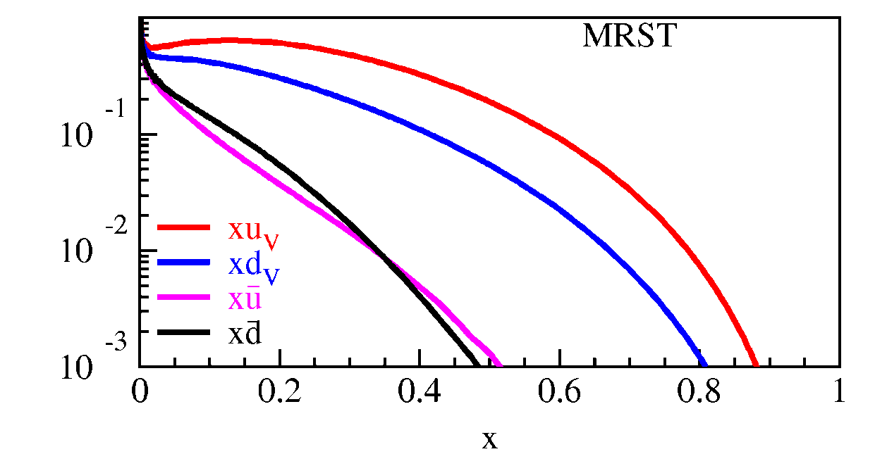
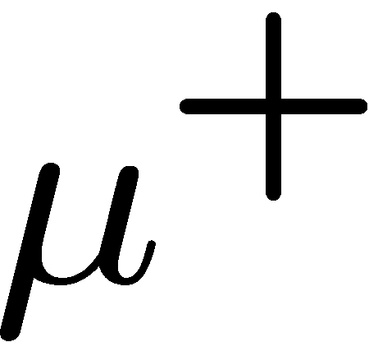
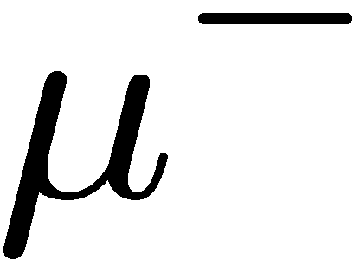
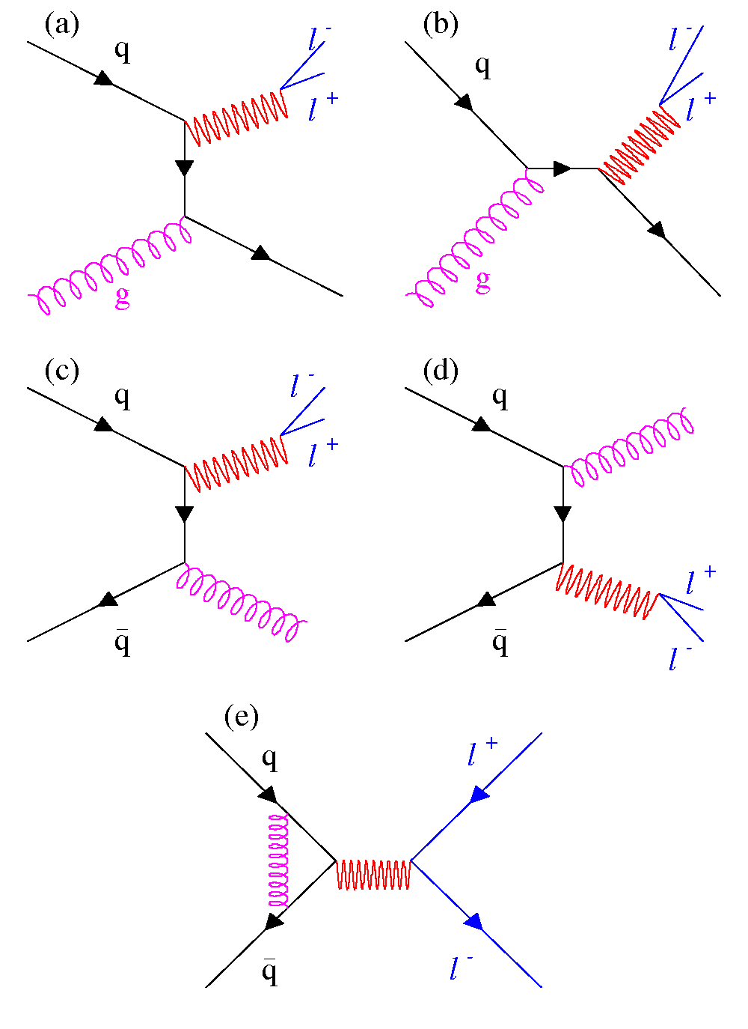
Drell-Yan cross section
x_{target}
x_{beam}
Detector acceptance chooses x_{target} and x_{beam}.
Fixed target, dipole focus ) high x_{F} = x_{beam} – x_{target}
Valence Beam quarks at high-x.
Sea-target quarks at low/intermediate-x.
Next-to-leading order diagrams complicate the picture and must be considered
These diagrams are responsible for 50% of the measured cross section
Intrinsic transverse momentum of quarks (although a small effect, λ > 0.8)

Slide 10
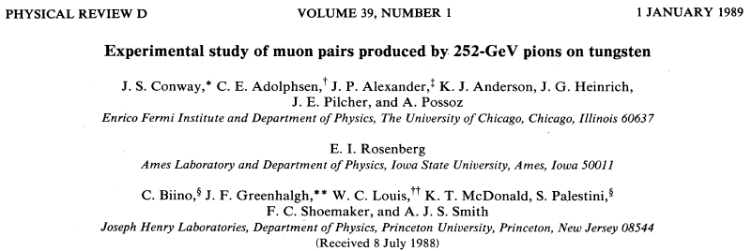
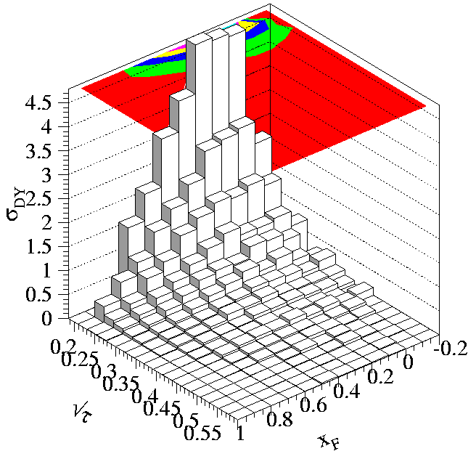
Pion Drell-Yan Data: Fermilab E615
Fermilab E615
252 GeV π⁻W Drell-Yan
Projected each data point onto x_{π} axis (diagonal)
Valence quark distributions extracted assuming
xq(x) = A x^{α}(1-x)^{β}

Slide 11
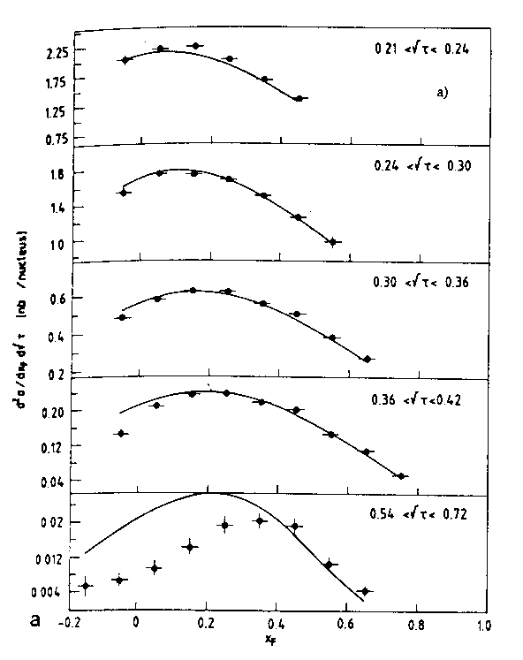
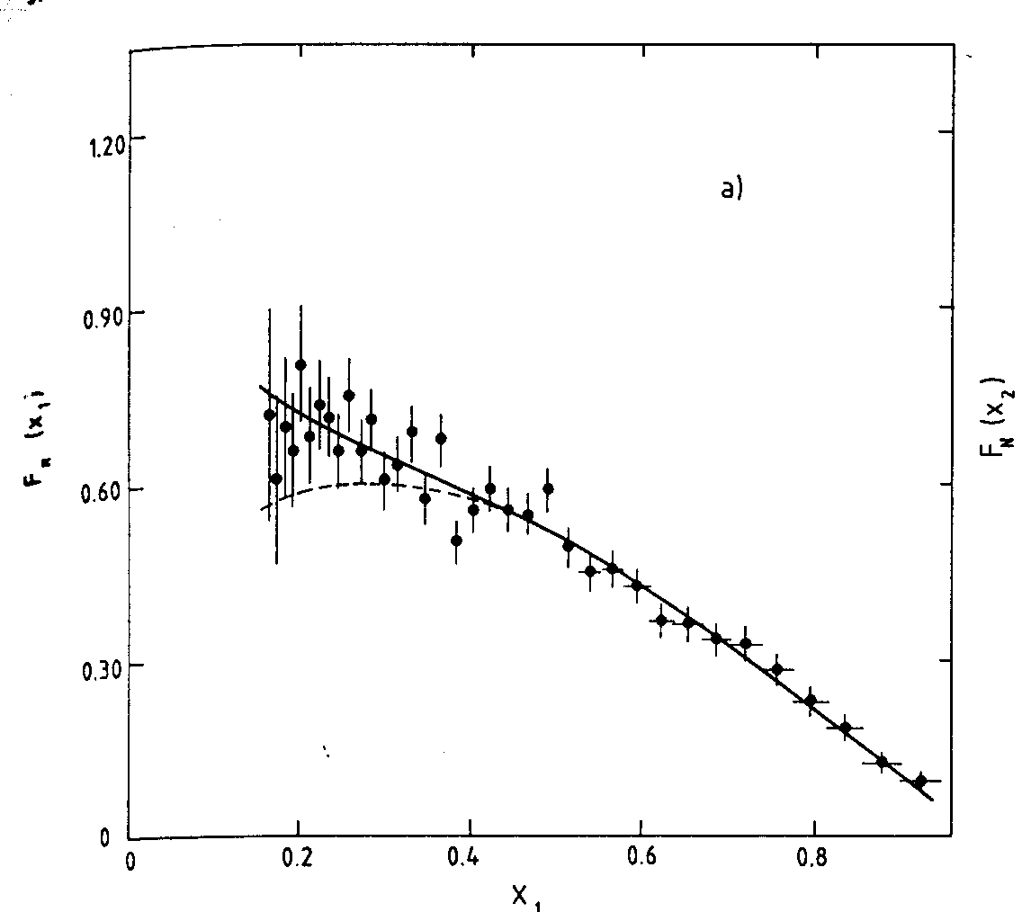
Pion Drell-Yan Data: CERN NA3 (π§) NA10 (π⁻)
NA3 200 GeV π⁻ data (also have 150 and 180 GeV π⁻ and 200 GeV π⁺ data). Can determine pion sea!
NA10 194 GeV π⁻ data

Slide 12
Models of the Pion
At some base Q₀
pQCD: xq(x)/ (1-x)^{β} β = 2
NJL: xq(x)/ (1-x)^{β} β = 1
DSE: xq(x)/ (1-x)^{β} β ¼ 1.9
Evolution to experimental Q increases β.
Structureless pion described by old parameterization with
α =0.67, β =1.13
(NJL Model)
Data favor linear slope at high-x_{Bj}
Remember what was measured
1
1
QCD
Evolution
q^{v}_{π}(x,q₀)
xq^{v}_{π}(x,q)
0
0
0
1
0
1
x
x

Slide 13
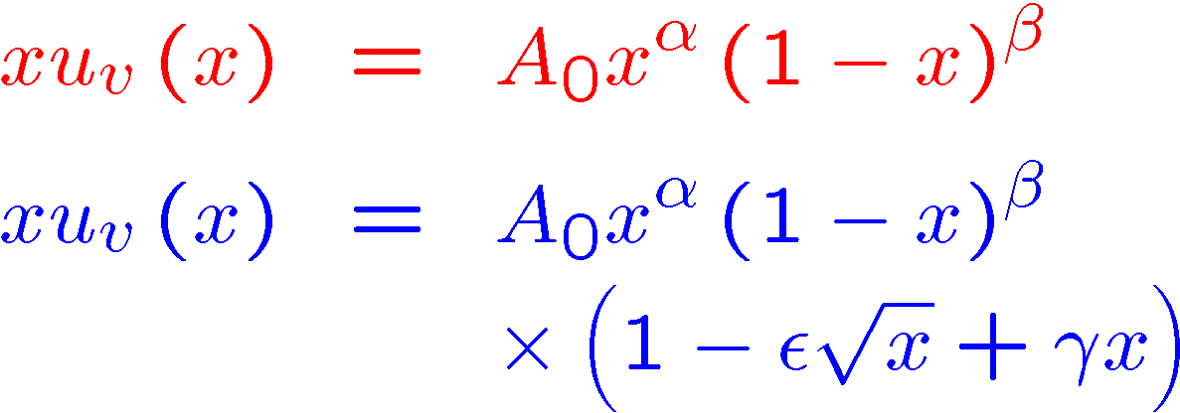
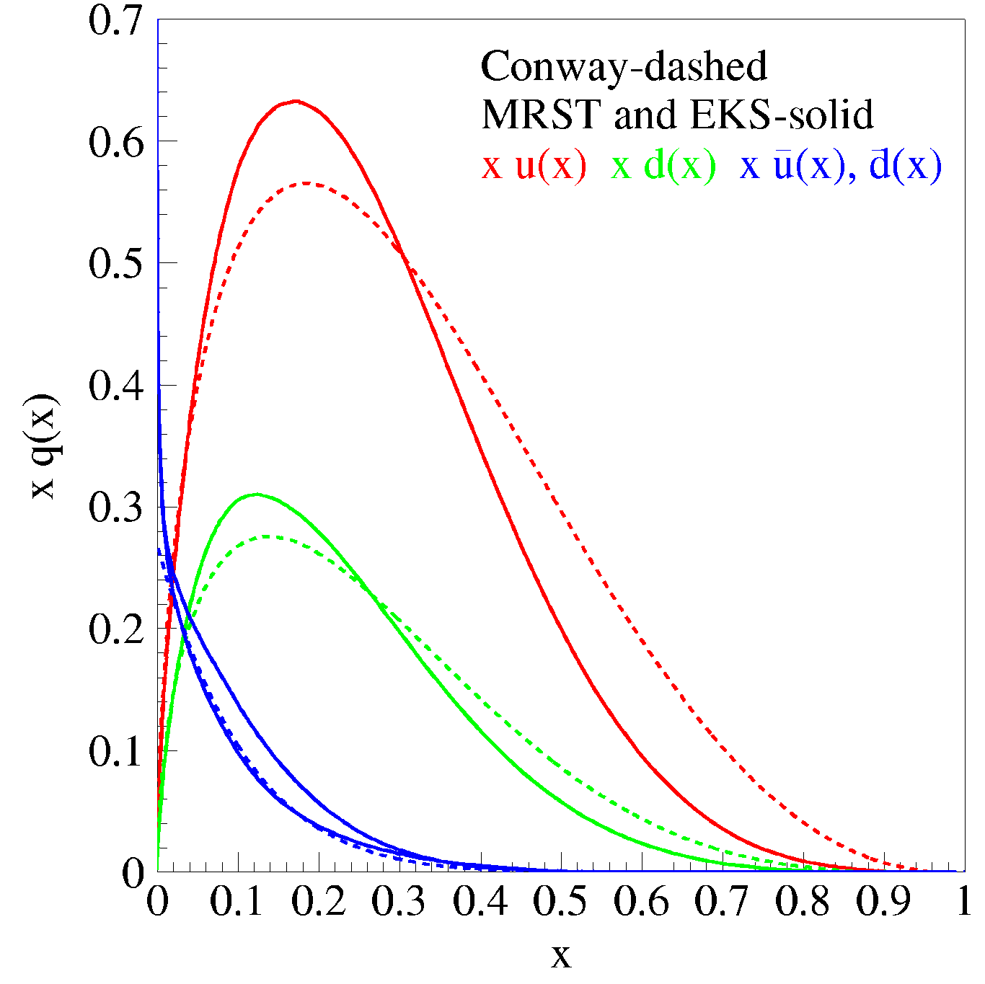
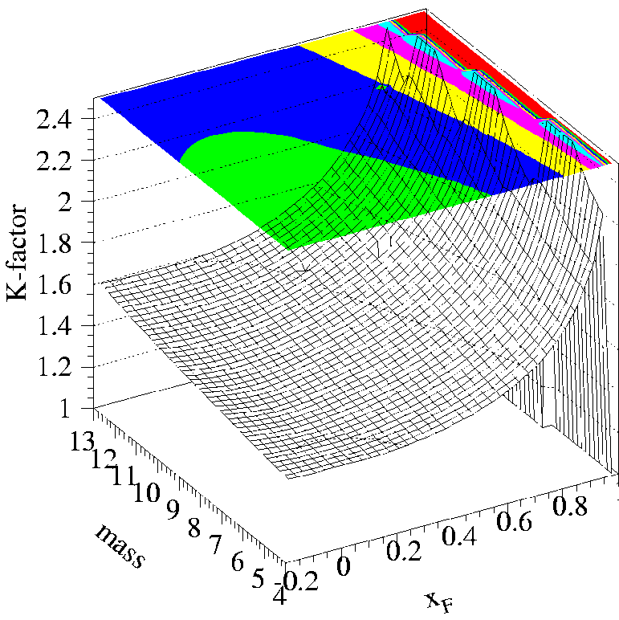
Could it be a problem with the treatment of the raw data?
More flexible parameterization (Hecht et al.)
Modern Proton PDF w/nuclear corrections
Inclusion of NLO terms rather than K-Factor
Look at 800 GeV proton-proton Drell-Yan:
Higher twist terms?
Proton-proton K-factor is not constant at high x_{F} (high x_{π})!

Slide 14
Fit of Drell-Yan Data in NLO
Number of valence quarks [defines normalization on q_{π}^{v}(x)]:
Total momentum conservation:
Gluon content determined from other data (NA3/10 and WA80 direct photon)
Sea quark parameterization from fits to π⁺/π⁻ Drell-Yan data

Slide 15
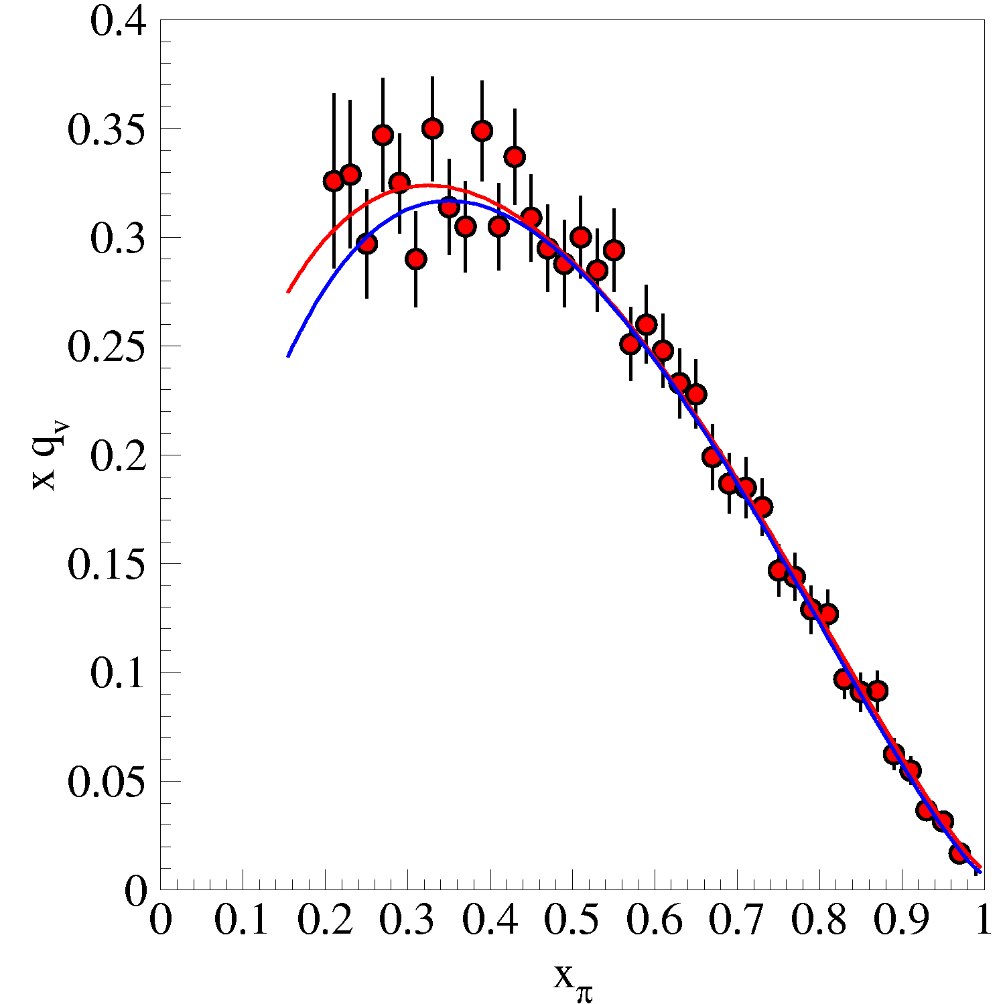
What did we learn?
Conway fit
Even with new freedom from parameterization, curve does not change.
Weak higher twist effects.
Data do NOT prefer convex-up shape at high-x_{π} as required by DSE analysis!
But this is not the end of the story!
New fit to
σ^{DY} data
(not to these points)

Slide 16
Soft Gluon Resummation
ω_{ab} is hard scattering function
Resum large logarithmic “soft” gluon contributions which arise as
Accomplished with combined Mellin and Fourier transform of the cross section
Aicher, Schäfer and Vogelsang, arXiv:1009.2481
Refit of pion Drell-Yan data

Slide 17
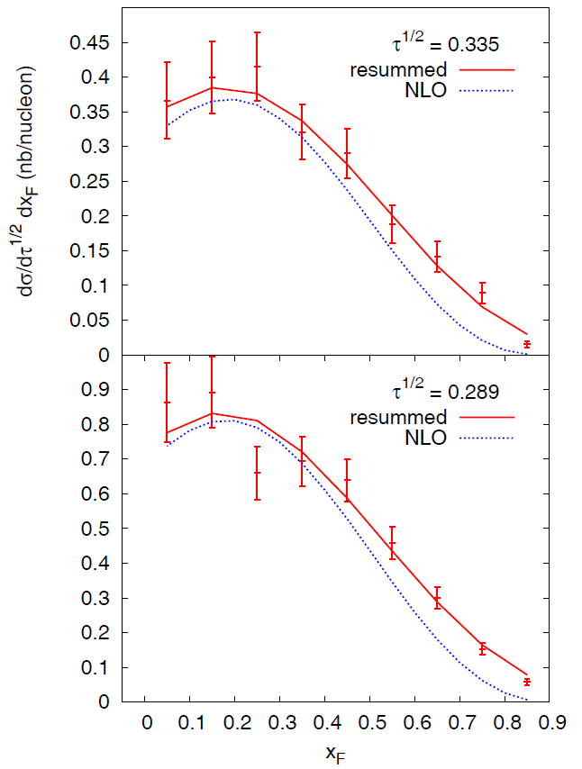
Soft Gluon Resummation
β = 2.03 ±0.06
QCD and Dyson-Schwinger survive!
pQCD: xq(x)/ (1-x)^{β} β = 2
DSE: xq(x)/ (1-x)^{β} β ¼ 1.9

Slide 18
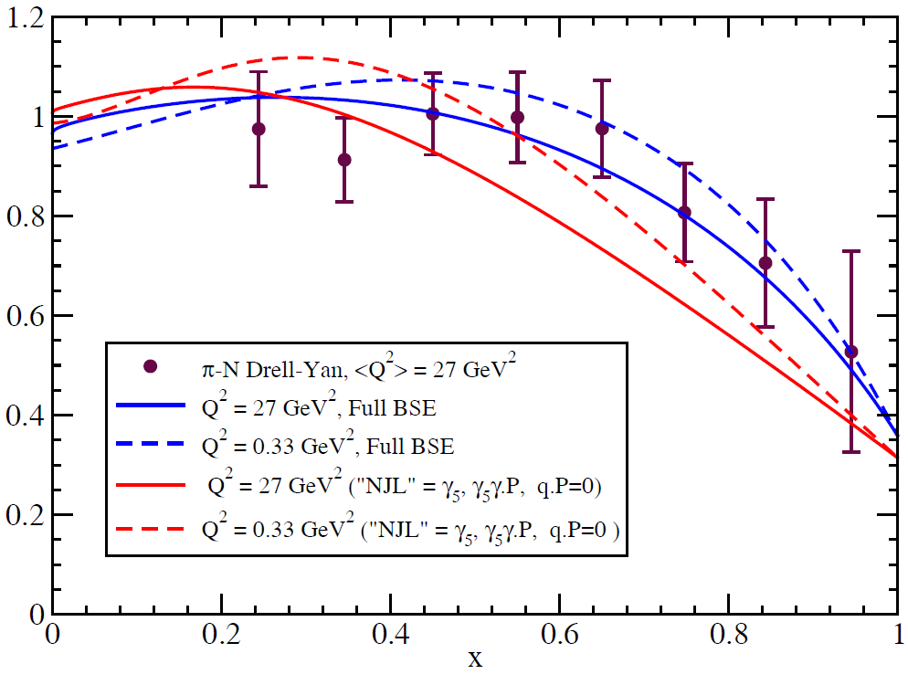
K/π Drell-Yan Ratios
More recent developments:
Predictions of the K/p Drell-Yan ratio based on Bethe-Salpeter Equations (BSE)
Can we get a Kaon beam to test this high-x_{Bj} structure of the Kaon?
A. Bashir, T. Nguyen, C.D. Roberts and
P.C. Tandy, in preparation
Data: Badier et al. Phys. Lett. B93 354 (1980)

Slide 19
Conclusions
Large x_{Bj} structure of the pion is interesting and relevant
Pion cloud & antiquark flavor asymmetry
Nuclear Binding
Simple QCD state & Goldstone Boson
Even with NLO fit and modern parton distributions, pion did not agree with pQCD and Dyson-Schwinger
Soft Gluon Resummation saves the day!
What does this mean for other large-x_{Bj} Drell-Yan data?
Additional Bethe-Salpeter predictions to check in π/K Drell-Yan ratio
Aicher, Schäfer and Vogelsang, arXiv:1009.2481
This work is supported in part by the U.S. Department of Energy, Office of Nuclear Physics, under Contract No. DE-AC02-06CH11357.

Slide 20
Backup

Slide 21
Good Fit? Residuals

Slide 22
Caveat: The K factor
K factor relates Leading Order to Next-to-Leading order cross section calculations:
σ^{exp} ¼ σ^{NLO} ¼ = K σ^{LO} where K¼ 2
Taken to be a constant independent of kinematics—Is it?
Possibly NLO analysis will show DSE behavior.
NLO fit can be done—remember this is “work in progress”—but at the cost of computer time.
Look at 800 GeV proton-proton Drell-Yan:
Proton-proton K-factor is not constant at high x_{F} (high x_{π})!

Slide 23
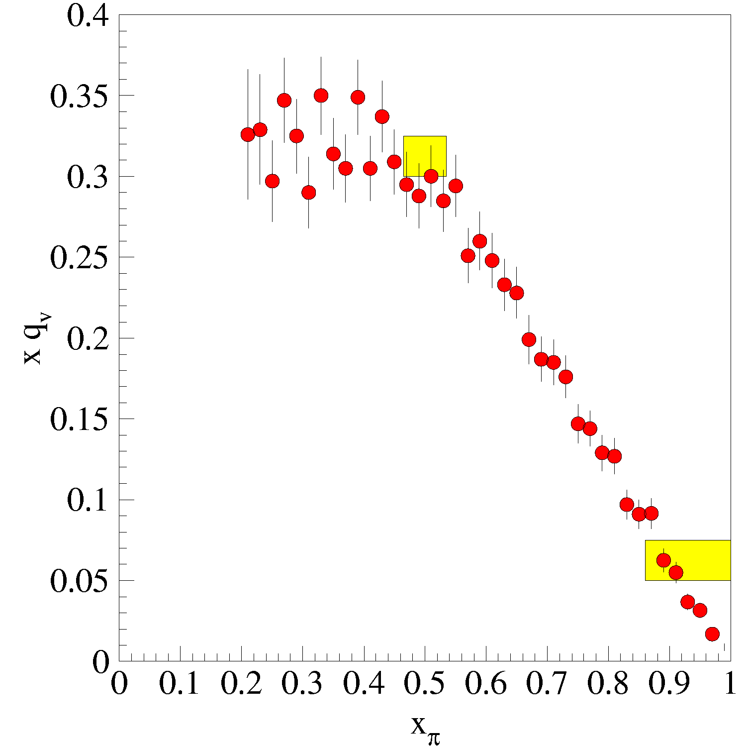
Caveat: x_{π} Resolution
J/ψ
x_{π} resolution
Best case, x_{π} and x_{N} contribute equally
(E866 experience Δx_{π} = 5 Δx_{N}) Δ x_{π}/x_{π}¼ 0.14)
x_{π} resolution not quoted in paper or thesis

Slide 24
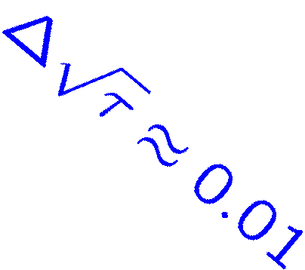
Caveat: x_{π} Resolution (cont.)
J/ψ
Resolution misrepresentation arises from projecting into x_{π}-x_{N} space.

Slide 25
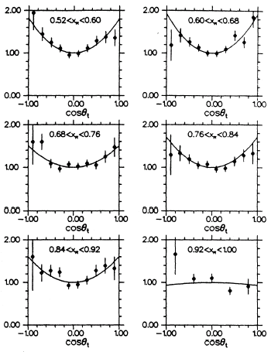
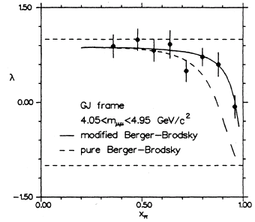
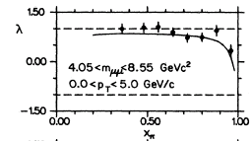
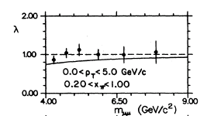
Drell-Yan Polarization & Higher Twist
Drell-Yan is transversly polarized:
dσ / 1+λ cos²(θ)
High x_{π} show higher twist—Berger and Brodsky:
dσ / (1-x_{π})²[1+cos²(θ)]
+ 4/9 x_{π}hk_{T}²isin²(θ) / m²
Include higher twist term in parameterization!

